Slide 1
Variables and Matrix Manipulation

Slide 2
Goals
Introduce the Notion of Variables & Data Types.
Master Arrays manipulation
Learn Arrays Mathematical Operations
Learn Basic String Manipulations
Learn to Use Array Editor
Solving Linear System of Equations

Slide 3
Variables

Slide 4

Variables
A MATLAB variable is an identified piece of data (= the assigned value)
The value is kept in the memory
The identifier provides a reference to the value such that your program can:
  Read it
  Use it for computation / change its value
  and save it back to memory
1 | 1 | 0 | 0 | 0 | 1 | 0 | 1

Slide 5
Variable Assignment
max_grade = 100;
Variable identifier (name):
  Letters
  Digits
  Underscore
Can’t start with a number
Case sensitive!!!
Can’t be a keyword
Value
Assignment operator
clear max_grade;
clear;
clear all;

Slide 6


Variable - Hands On
Exercise 1:
  Consider the following:
    x = 50;
    disp = 100;
    disp(x);
    builtin(‘disp’, x);
    clear disp;
    disp(x);
  What happened?
The disp variable overrides the disp built-in function
Don’t override built-in functions!!!

Slide 7
Variable - Hands On (II)
Exercise 2:
  Define a variable “grade” and assign the value 80 to it.
  “Personal Factor” - Now add to the grade its square root (there are several options to solve this…)
  Define a “classFactor” and assign 10 to it.
  Define a “finalGrade” variable and assign the value of the factored grade plus the class factor to it.
  What is the final grade?
Lets look at the workspace window.
Try to change grade value to 100.

Slide 8

Workspace functions
which(‘linspace’);
  locates a function or identifies as variable
clear x;
save(‘file_name’, ‘var1’, ‘var2’, …)
  saves the workspace to a “.mat” file
load(‘file_name’);
  loads variables from a “.mat” file into the workspace
Example:
  Create some a,b,c variables
  save(‘tutorial2.mat’, ‘a’, ‘b’,’c’);
  clear;
  Load(‘tutorial2.mat’)

Slide 9
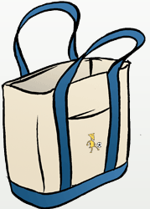
Data Types

Slide 10
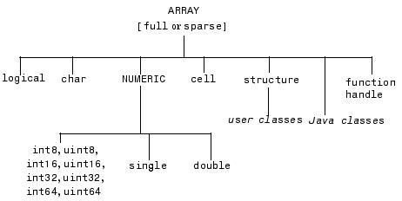
Data Types (Variable types)
A scalar is also an array of size 1x1
Next lectures…
Everything in Matlab is an array!

Slide 11
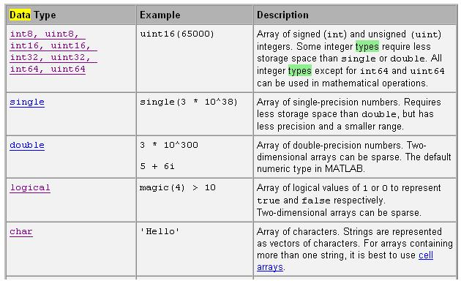
Data Types (Variable Types)
Integer
Default

Slide 12
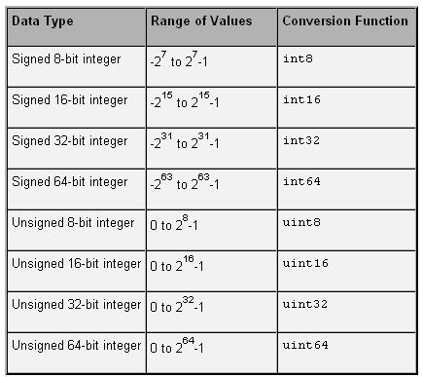
Data types - Numeric
Integer:
  a = int16(100);
  Be careful of
  memory overflow
  b = int8(5000);
Real(/Complex):
  x = double(235.5);
  x = single(235.5);
  x = 235;

Slide 13
Numeric Data Functions
A summery of numeric functions:
  Help -> contents -> MATLAB -> Functions -> Mathematics -> Array and Matrices (and also the rest of the items…)
Notice:
  isinf, isnan, floor, ceil
Infinite
Is Not A Number

Slide 14
Arrays Manipulation

Slide 15


Arrays and Matrices
A Matlab variable is an array.
  A one dimensional array is named vector
  A two dimensional array is named matrix
Creating arrays
  Which are equal?
    a = [1 2 3 4];
    b = [1, 2, 3, 4];
    c = [1; 2; 3; 4];
    d =1:1:4;
    e = (1:4)’;
Space / comma – New element in same line
New line / Semicolon – new line
Colon operator – from:step:to. Default step is one.
‘ operator- transpose (near the enter key)

Slide 16
linspace and logspace
linspace(0,100,51);
Why? Consider 0:0.33:1 or 0:0.08:1
logspace(1,10,11);
Same, but logarithmically spaced between 10^1 and 10^10
Min value
Max value
Number of points

Slide 17

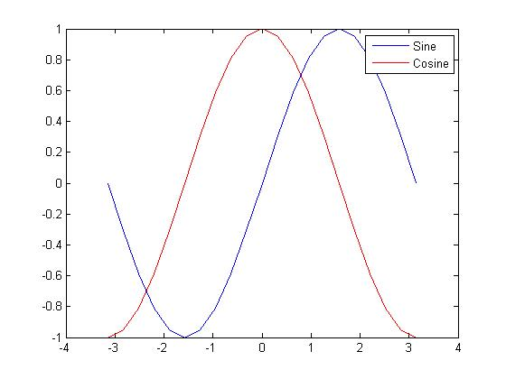
Drawing the Sine and Cosine Functions
Reminder:linspace
Use the commands we learned to define x as:
Compute y and z – the sine and cosine function of x respectively.
Draw a plot of the sine and cosine function of [-π, π] using the following code:
    hold off; plot(x,y,'b-'); hold on; plot(x,z,'r-'); legend('Sine', 'Cosine');
x = linspace(-pi,pi, 21);
% another way: x = (-1:0.1:1) * pi;
y = sin(x);
z = cos(x);

Slide 18
Multidimensional Array Indexing
Second dimension (Column)
A = [1, 2, 3; 4, 5, 6; 7, 8, 9]
Multi dimensional arrays:
  B(:, :, 1) = A;
  B(:, :, 2) = A;
  B(:, :, 3) = A;
Getting the matrix size:
  size(A)
  See also: length(A) numel(A)
Subscripts to single index:
  sub2ind(size(A), 2,3)
  A(2,3) <->A(8)
A =
1 2 3
4 5 6
7 8 9
First dimension (Row)
Third dimension (Page)
B =
1 2 3
4 5 6
7 8 9
  ans = 3 3
1 2 3
4 5 6
7 8 9
1 2 3
4 5 6
7 8 9
1 2 3
4 5 6
7 8 9
  ans = 8

Slide 19

Arrays Manipulation
a = [1, 2; 3, 4] | a = 1 2 3 4
a’ % or a.’ | ans= 1 3 2 4
a(2) a(:) | ans= ans = 1 3 2 3 4
a(1,end:-1:1) | ans = 2 1
b = fliplr(a) | ans = 2 1 4 3
c = flipud(a) | ans = 3 4 1 2
Array flattening
The last coordinate in the dimension

Slide 20
Arrays Manipulation– More…
d = 1:2:9 | d = 1 3 5 7 9
e = 2:2:10 | e = 2 4 6 8 10
f = [d; e] | f = 1 3 5 7 9 2 4 6 8 10
g = [d(1:3), e] | g = 1 3 5 2 4 6 8 10
reshape(a,1,4) | ans = 1 3 2 4
repmat(e,2,2) | ans = 2 4 6 8 10 2 4 6 8 10 2 4 6 8 10 2 4 6 8 10
Vertical Array Concatenation
Horizontal Array Concatenation
See also: diag()

Slide 21
Assignment into Array
1 | 2 | 3
4 | 5 | 6
7 | 8 | 9
>> A = [1, 2, 3; 4, 5, 6; 7, 8, 9]
A =
1 2 3
4 5 6
7 8 9
>> A(3,4)
??? Index exceeds matrix dimensions.
>> A(4,4) = 10
A =
1 2 3 0
4 5 6 0
7 8 9 0
0 0 0 10
?
1 | 2 | 3 | 0
4 | 5 | 6 | 0
7 | 8 | 9 | 0
0 | 0 | 0 | 10
Notice the difference!

Slide 22

Assignment into Array
>> A = [1, 2, 3; 4, 5, 6; 7, 8, 9]
A =
1 2 3
4 5 6
7 8 9
>> A(:) = 21:30
??? In an assignment A(:) = B, the number of elements in A and B must be the same.
>> B = [21, 22, 23; 24, 25, 26]
B =
21 22 23
24 25 26
>> A(1:2,1:3) = B
A =
21 22 23
24 25 26
7 8 9
1 | 2 | 3
4 | 5 | 6
7 | 8 | 9
Notice the difference!
21
22
23
24
25
26
>> A(1:2,1:3) = 10
A =
10 10 10
10 10 10
7 8 9
Subscripted assignment dimension must match!
Scalar expansion

Slide 23

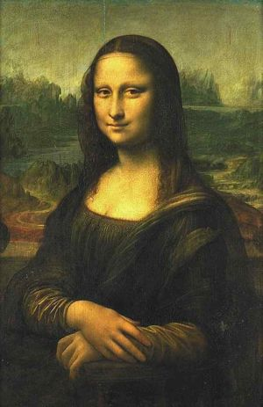

Example - Image Manipulation
Images are represented by matrices
Lets use this to visualize matrix manipulation
“Andy Warhol” style.
10 | 21 | 10 | 21
73 | 21 | 18 | 21
10 | 4 | 8 | 21
3 | 21 | 10 | 45
8 | 21 | 2 | 21

Slide 24
Standard Arrays
What is it good for?
zeros(10,10)
ones(10,10)
rand(10,10)
randn(10,10)
eye(10,10)
Allocate memory in advance!
Create a sample.
Identity matrix
1 0 0
0 1 0
0 0 1

Slide 25
Find & logical Arrays
>> index_larger_than5 = find(A>5)
index_larger_than5 =
1
6
7
8
>> A(index_larger_than5) = 10 % A(find(A>5))= 10
A =
10 1 10
3 5 10
4 10 2
>> [r c] = find(A>5)
r =
1
3
1
2
c =
1
2
3
3
>> A = magic(3)
A =
8 1 6
3 5 7
4 9 2
>> is_larger_than5 = A > 5
is_larger_than5 =
1 0 1
0 0 1
0 1 0
>> class(is_larger_than5)
ans =
Logical
>> A(is_larger_than5)
ans =
8
9
6
7
Array of indices
Logical operator
Assignment using indices array
Logical array
>> A(r,c) = 20
% wrong!
A =
20 20 20
20 20 20
20 20 20
Matlab functions output depends on the # of output parameters!
What is wrong?
A([1 3 1 2], [1 2 3 3]) = 20
Array can be indexed with logical array!
find can return subscripts

Slide 26
Short Example
Consider the martix: A = magic(6);
  Try to run A(1:3,1:3) = ones(7,7); What did you get?
Replace all element larger than 20 with the value 100
Now, make A be only its last three columns
Then compute the mean of the fourth row.
A = magic(6)
A(:,:) = ones(7,7)
??? Subscripted assignment dimension mismatch.
A( find(A > 20) ) = 100;
A = A(:,4:6); % or A(:,1:3) = [];
mean(A(4,:))

Slide 27
Arrays mathematical operations

Slide 28

Array arithmetic
Element by element:
  A+B
  A-B
  -A
  A.*B
  A./B
  A.\B
  .^
Matrices dimensions must match
+ * /\ by scalar are element-wise
C = A*B :
  A #columns == B #rows
A^p
Try to run the following:
x = 1:3;
y = x';
x .* y'
x*y
y*x
Search help for : “Arithmetic Operators“

Slide 29

“Grades” Exercise Revisited
Consider the following:
Grade | 80 | 77 | 70 | 60 | 65
Participation in class | 1.10 | 1.05 | 1.07 | 0.99 | 1.10
We want to compute the final grade as follows:
  Multiply each grade by the class participation score
  Then add 10 points to all grades?
Answer:
>> grades = [80 77 70 60 65];
>> participation_in_class = [1.10, 1.05, 1.07, 0.99, 1.10];
>> final_grades = (grades .* participation_in_class) + 10
final_grades =
98.0000 90.8500 84.9000 69.4000 81.5000

Slide 30
String Manipulations

Slide 31
Strings as Char Arrays
Strings are represented as Char array
Assigning a string:
a=‘I am a string’
>> a = 'It is easy ';
>> b = 'to concatenate strings!';
>> [a, b]
ans =
It is easy to concatenate strings!
Char arrays can be concatenated like numerical arrays
Lets try it:
s=‘I am a string’ | s = I am a string
s(1:4) | ans = I am
[s([1:9,6,10]) '!'] | I am a star!
s(end:-1:1) | ans = gnirts a ma I

Slide 32
Working with Strings – Generating Output
>> c = num2str(3.14157)
c = 3.1416
>> class(c)
ans = char
>> d = str2num(c)
d = 3.1416
>> class(d)
ans = double
>> ['pie value is: ' num2str(3.14157)]
ans = pie value is: 3.1416
Tip
num2str
str2num
Are very useful for output string generation

Slide 33
Working with strings – char matrices
>> str_mat = ['one '
'two '
'three']
str_mat =
one
two
three
>> class(str_mat)
ans = char
>> size(str_mat)
ans = 3 5
>> str_mat = … char('one','two','three')
str_mat =
one
two
Three
Concatenate vertically!
Rows length must be equal! (a square matrix)

Slide 34
Working with Strings – String Comparison
Compare the strings
>> strcmp('abcd','abc')
ans =
0
>> strncmp('abcd','abc',3)
ans =
1
Compare the first “n” characters of the two strings
Check also: strfind

Slide 35
Array Editor

Slide 36
Array Editor and Array Display
Display:
  Omitting the “;”
  disp(‘hello world’);
  [‘Today we added’ num2str() ]
  Example:
    three = 2;
    [‘One plus one is:' num2str(three)]
Array Editor:
  From: work space, “open selection”
  Displays variables
  Edit variables value
  Copy-paste from Excel (grades example)

Slide 37
Solving Linear System of Equations
Yuval Hart, Weizmann 2010 ©

Slide 38
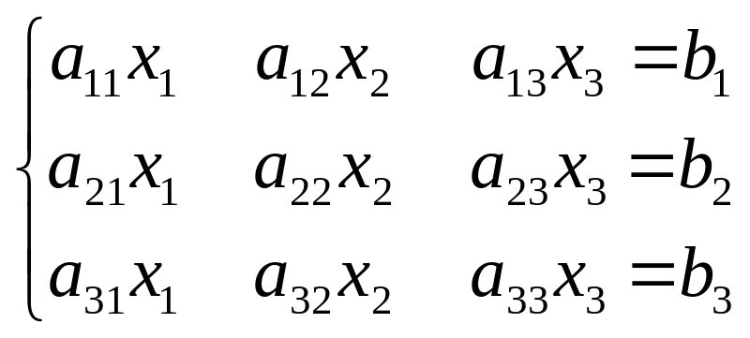
Epilogue - Solving Linear Systems of Equations
Say we want to solve the following system:
A = [ 1 1 1 ; 1 2 3 ; 1 3 6 ];
b = [3; 1; 4];
x = A\b;
Solution: x = 10 -12 5
More: search help “solving linear equations”
Ax=b

Slide 39

Epilogue - Solving Linear Systems of Equations
Solve the following problem:
1x+2y+3z = 366
4x+5y+6z= 804
7x+8y = 351
Answer:
A = [1 2 3
4 5 6
7 8 0];
b = [366; 804; 351];
x = A\b
Result:
x =
25.0000
22.0000
99.0000

Slide 40
Summary
Introduce the Notion of Variables & Data Types.
Master Arrays manipulation
Learn Arrays Mathematical Operations
Learn Simple String Manipulations
Learn to Use Array Editor
Solving Linear System of Equations

